Slide 1
ENG 346 Data Structures and Algorithms for Artificial Intelligence Lists Tuples Maps
Dr. Mehmet PEKMEZCİ
mpekmezci@gtu.edu.tr
https://github.com/mehmetpekmezci/GTU-ENG-346

Slide 2
Sequences
Built-in types: list, tuple, and str
Sequence supports indexing, e.g. A[i]
These types uses an array to represent the sequence.
An array is a set of memory locations that can be addressed using consecutive indices
Indices start with 0.
A
0
1
2
i
n

Slide 3
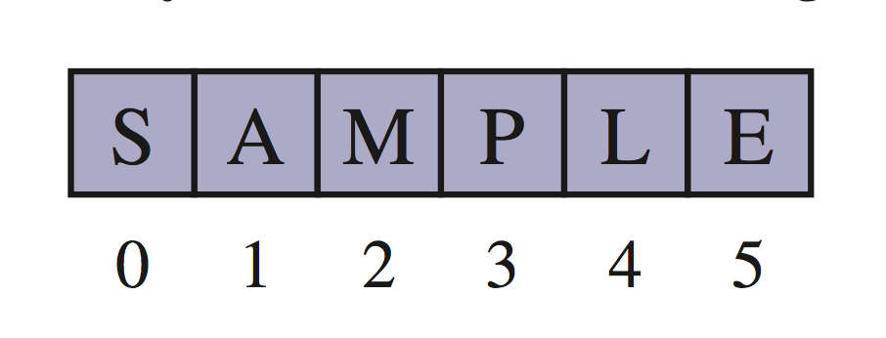
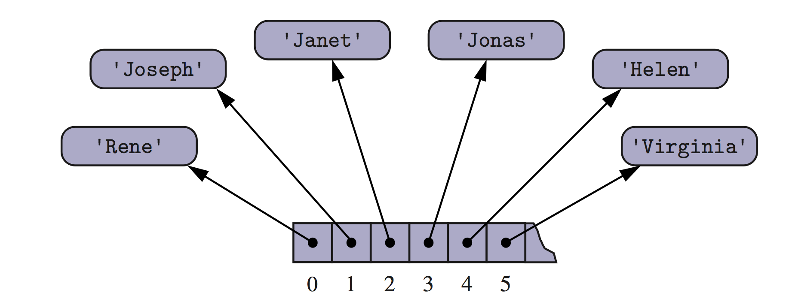
Arrays as Memory Cells
An array can store primitive elements, such as characters, giving us a compact array.
An array can also store references to objects.

Slide 4
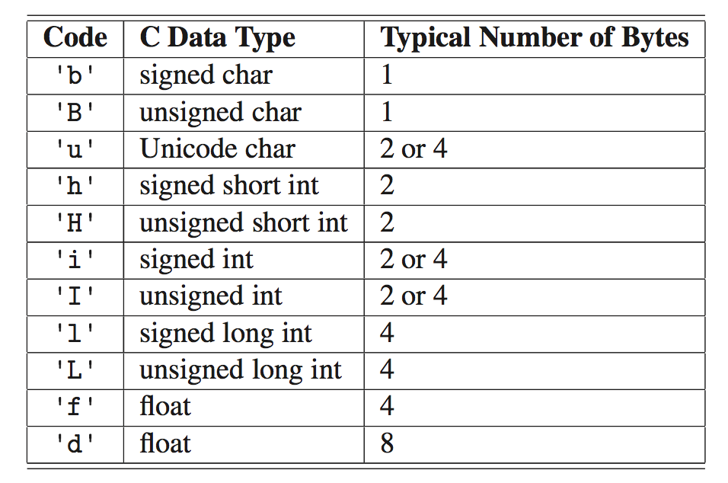
Compact Arrays
Defined in “array” module.
Provides compact storage for arrays of primitive data types.
Example:

Slide 5
Array Operations
array.insert(i, x): add x to index i → O(n)
array.append(x): add x to end of array.
array.remove(x): remove first occurrence of x → O(n)
array.pop(i=-1): remove and return ith element.
array.index(x): search and return element x in the array.
array.tolist(): return array content in Python List Class.
…

Slide 6
Lists
Built-in list Class
Denoted with []
Allow duplicate values
Allow mixed types
Index starts with 0

Slide 7
Lists – continued
Let A = ["apple", "banana", "cherry", "orange", "kiwi", "melon", "mango"]
A[0] → "apple"
A[1] → "banana"
A[-1]: last item in the list → "mango"
A[1:]: new list which starts at index 1
A[:2]: first two items → ["apple", "banana "]
...

Slide 8
Lists – continued
A.append(x): Add x to the end of the list.
A.extend(B): Add items in list B to the end of list A.
A.append(B): Add list B to the end of the list A.
A.remove(x): Remove first occurrence of item x.
A.pop(i=-1): Remove and return ith element.
del A[i]: remove ith element.

Slide 9
List Comprehension
Let A = list(range(10))
B = []
for x in A:
B.append(x**2)
versus
B = [x**2 for x in A]

Slide 10
List Comprehension – continued
fruits = ["apple", "banana", "cherry", "kiwi", "mango"]
newlist = [x for x in fruits if "a" in x]
# newlist = ["apple", "banana", "mango"]

Slide 11
Tuples
Built-in list Class
Cannot be changed
Denoted with ()
Allow duplicate values
Allow mixed types
Index starts with 0

Slide 12
Tuples – continued
Let B = (1, 5, 7, 9, 3)
Content cannot be changed
B[0] → 1
C = ("A", ) # tuple with one item

Slide 13
Tuples – continued
Function returning tuples:
def stats(data):
return max(data), min(data)
stats([1, 3, 5, 7, 9]) # returns tuple
(9, 1)

Slide 14
Dictionary
Built-in list Class
Denoted with { }
Allow mixed types
Key-value pairs
Unordered
Dynamic sizing
Accessed by keys
Allow dictionary comprehensions

Slide 15
Examples
# Iterating through key-value pairs
for key, value in somedict.items():
print(key, ":", value)

Slide 16
Sets
Built-in list Class
Denoted with { }
Allow mixed types
Unordered
Dynamic sizing
Allow set comprehensions
Common set operations, e.g. union, intersection, etc.

